Slide 1
The Battle of Neighborhoods
IBM-Data Science Specialization – Capstone Project

Slide 2
Introduction
Problem Background
The famous Barbeque Nation owned by Sayaji Hotels Ltd is one of the high-end buffet restaurants which takes you into the world of good food with happy vibes. This place was founded in 2006 by one of their Promoters. They currently own and operate 138 outlets in India, 5 outlets in UAE, 1 outlet in Malaysia and 1 outlet in Oman.
One of the leading casual dining chains in India, Barbeque Nation pioneered the concept of “over the table barbeque” live grills embedded in dining tables – allowing guests to grill their own barbecue’s right at their tables.
Indian cuisine is a natural part of the diet in the markets in which the Barbeque Nation Restaurants operate. They continue to offer new menu options, both vegetarian and non-vegetarian, largely based on Indian cuisine and use seasonal customer preferences to introduce new dishes.
This is just an example, there are many such food chains and restaurants across India that could go international and would be open to the idea of setting up business in Ireland.

Slide 3
Problem Description
As mentioned in the description, there are many popular restaurant chains are as of now only serving across India, but if they were to go international, specifically open their first international chain of restaurants in Ireland. There are various factors that they’ll have to consider
Example of few such factors are,
* Popular cuisines in Ireland
* How popular is Indian food in Ireland?
* What are existing Indian Restaurants chains in Ireland?
* Which county is preferable to open their first restaurant ?
* Are there "similar" restaurants? If so, what specialty do that have?
This will be more of a comparative analysis of existing food chains/restaurants across few counties in Ireland considering data from foursquare API.

Slide 4
Targeted Audience
This is very generic analysis on existing food restaurants chains across few counties in Ireland. Specific for research purpose, this analysis could also be extended towards restaurant and food chain owners with specific cuisines looking to open their businesses in Ireland and want to understand the current situation about people preferences, food popularity and existing businesses across required neighborhood.

Slide 5
Data
Based on our problem definition below are the sources from where each datasets were obtained,
Population dataset was obtained from: https://www.cso.ie/en/census/census2016reports/census2016smallareapopulationstatistics/
The shapefile used in the project was obtained from OSi Website: https://data-osi.opendata.arcgis.com/datasets/0d5984f732c54246bd087768223c92eb_0?geometry=-23.747%2C51.281%2C8.927%2C55.844
The geographical co-ordinates were copied manually from following website - https://latitude.to/map/ie/ireland/regions
The list of international cuisines were extracted from https://developer.foursquare.com/docs/build-with-foursquare/categories/
The ratings and price for different restaurants were obtained using google places API key.
Read more: https://developers.google.com/places/web-service/overview

Slide 6
Methodology
To keep the data obtained and analysis consistent and relevant, all the location data and query to foursquare API and google API was done for each administrative aeras within Republic of Ireland. This was the data that could be accurately obtained at the highest level. Having data per administrative area level could also be used for future analysis of different administrative areas for various statistics and research.

Slide 7
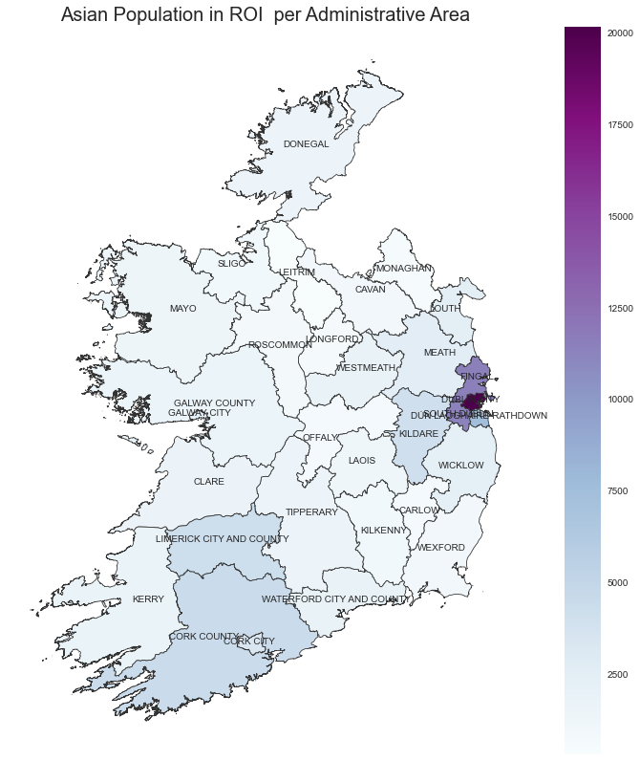
Visualizing the Asian Population in Ireland
Analysis was begun with an assumption that, the more the Asian Population, the more Indian Restaurants in the area.
So based on the population dataset, I was expecting a larger number of Indian restaurants in and around Dublin City and it’s neighbouring administrative areas.

Slide 8
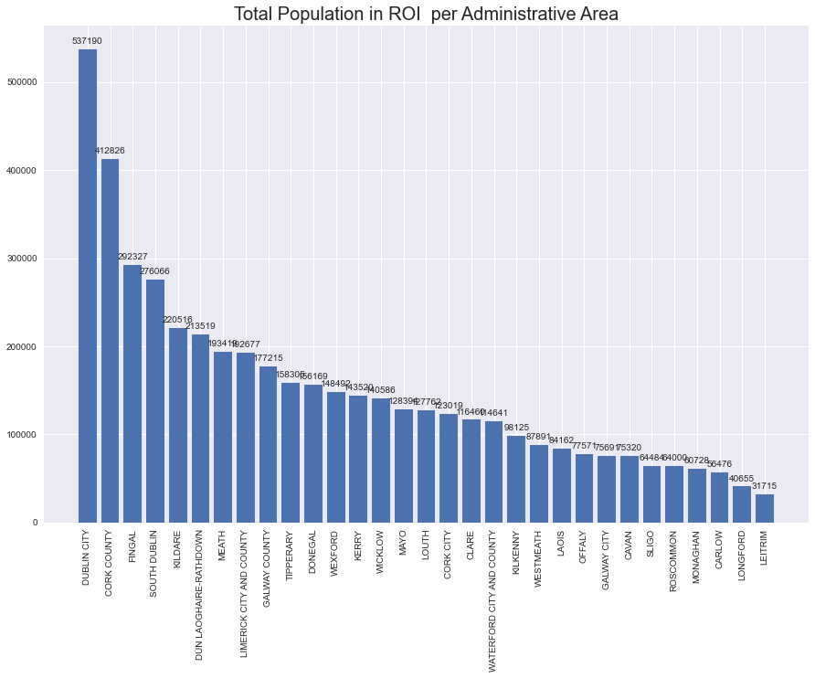
But for analysis within the project choose top 10 administrative areas based on overall population in the administrative areas.

Slide 9
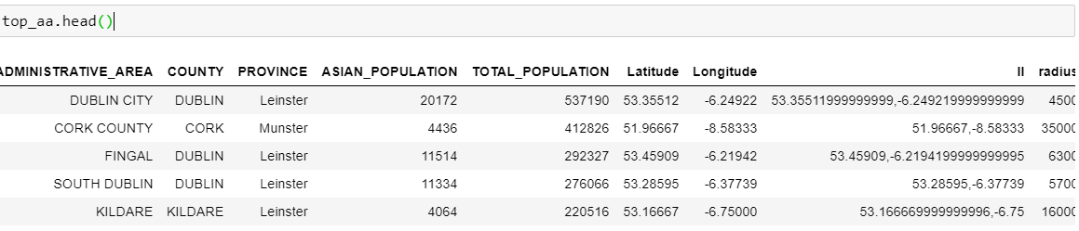
The data on last slide is combined with geographical dataset (queried manually) to obtain the following table after which top 10 counties are locked in analysis.
Even thou an assumption is set that, the more the Asian Population, the more Indian Restaurants in the area I am analyzing top 10 counties by total population.
In the data frame above, radius for analysis for each administrative area was obtained by using maps.ie to Measure Circle / Radius on a map to determine approx. shortest radius of each administrative area without overlap.

Slide 10
Foursquare API
For next part of the analysis, i.e., to obtain the number of restaurants serving each cuisine and their details the Foursquare API is used. As a user, you need a Developer Account, in order to get the credentials for authenticating your HTTP requests. For each administrative are selected above, we call the API for the restaurants of each kind of international cuisine, one by one, and store the results in a Pandas DataFrame, in order to process it later and perform some interesting analytics.
From the data, we manually extract the categories under food corresponding to national cuisines (Spanish, Indian, Thai...), in order to be able of filtering the restaurants only by the nationality, and not other irrelevant criteria, like vegan, halal, burger place.
For each administrative area, call to API is made for the restaurants of each cuisine. i.e., query.get(‘https://api.foursquare.com/v2/venues/explore?&client_id={}&client_secret={}&v={}&limit={}&radius={radius}&ll={lat_lon}&categoryId={category_id}'.format())

Slide 11
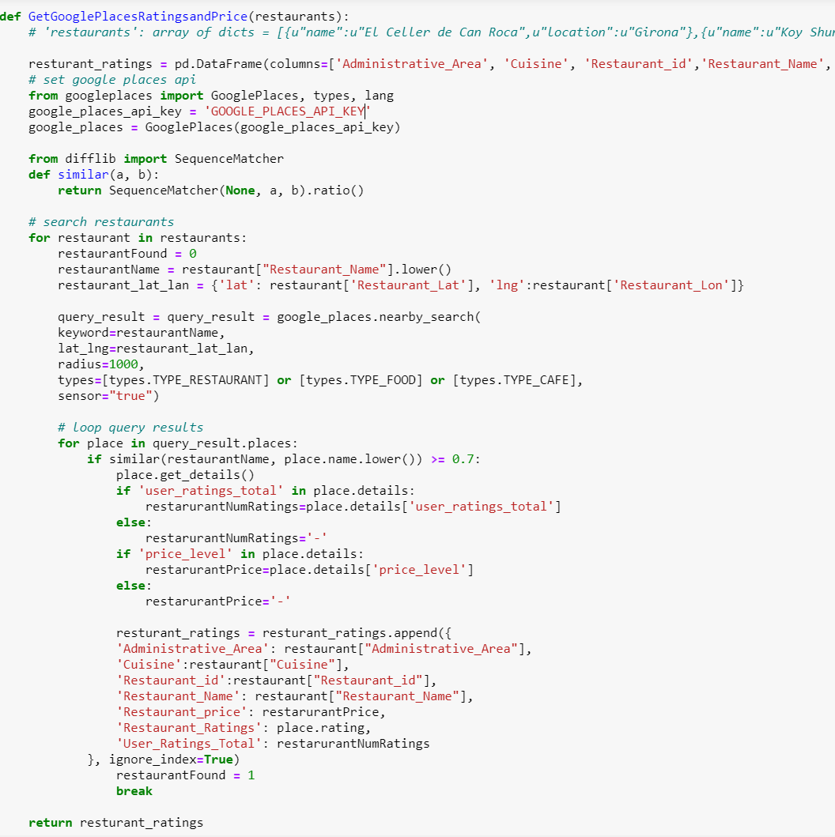
Google Places API
After preprocessing the data obtained from Foursquare API, I further went on to use the Google Places API to determine the ratings and price of each restaurant that is available to us in the resturants_details DataFrame. It was a surprise that only a few restaurants out of the total had ratings and price details available for them.

Slide 12
Results
Popular cuisines in Ireland - how popular is Indian food in Ireland?
Before looking at the results, it's important to make following observations. In this project, we're working with 65 different types of cuisines, those available in Foursquare corresponding to a country. Since the results shown here are in percentages (over 100), in an equative division, a 1.54% would correspond to each cuisine . I think this is an important clarification, since without it, it might seem that a percentage of 20% for some cuisine in some administrative are might not be too much, when actually it would be a really high percentage.
The first analysis, the top 10 cuisines for each administrative area, showed that in most of the areas, the Italian was the winner. However, in some area like South Dublin, Galway and Tipperary Chinese is the winner. Indian however is within top 5 popular cuisines with it being top choice of cuisine in Meath.

Slide 13
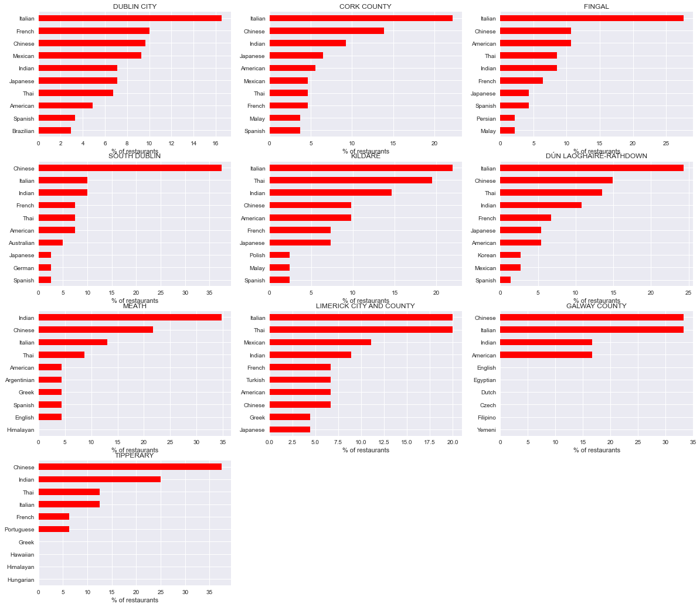
Based on number of restaurant serving cuisines, Top 10 cuisines in each administrative area are,

Slide 14
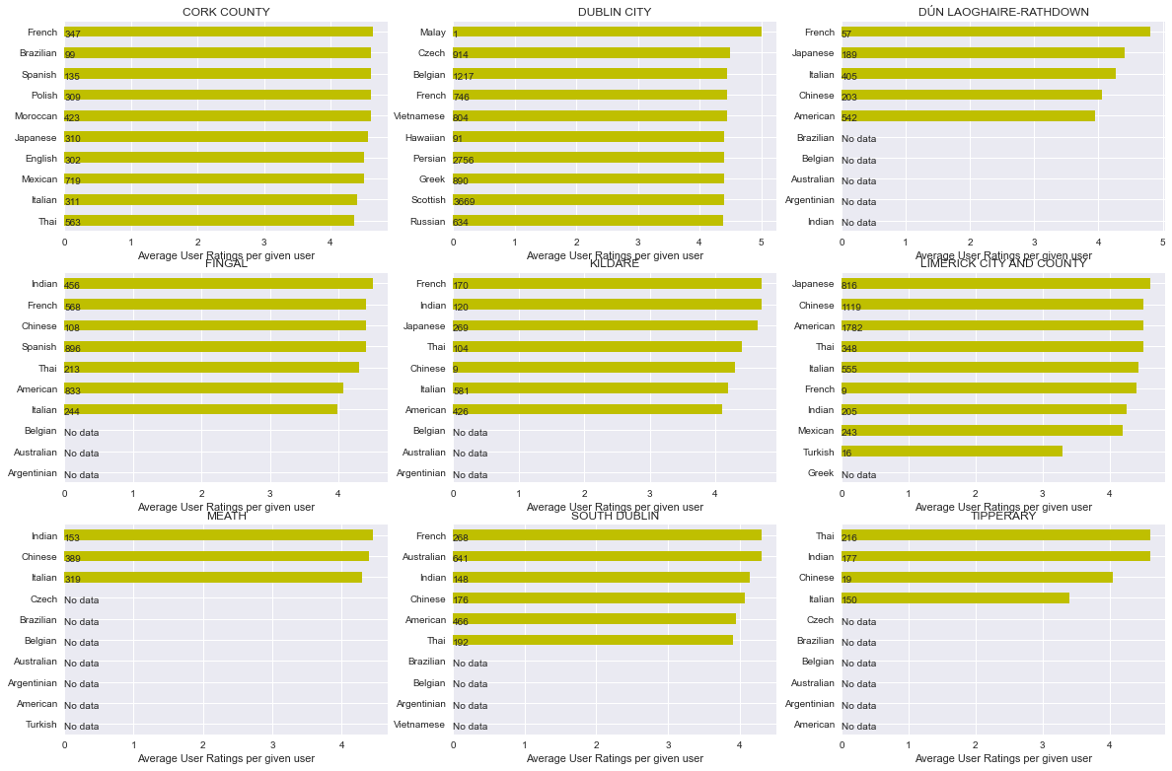
Popular 10 cuisine based on average restaurant ratings serving cuisine in particular administrative areas are:
In the above plot you can clearly see that there is data missing for administrative area Galway and that the average ratings per cuisine is also fluctuating across different administrative area.
But in Meath, the top three cuisines remain the same based on user ratings too.

Slide 15
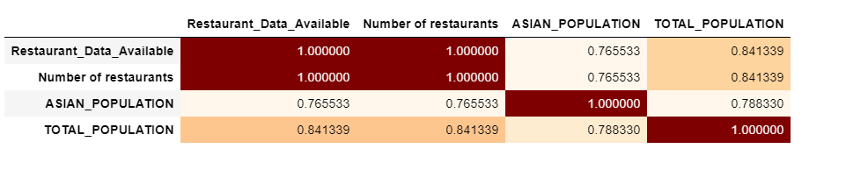
Which county is preferable to open their first restaurant ?
Based on the popularity above, Meath County seems most preferable administrative area to open new Indian Restaurant.
But to explore more, merge population dataset with restaurants summary and restaurants details for restaurants serving Indian Cuisine to test the assumption that the more the Asian Population, the more Indian Restaurants, there is a higher positive correlation between the two.
The data frame above suggested that there is a higher positive correlation between total population and number of restaurants serving Indian than Asian population and number of restaurants serving Indian.
And based on above analysis, the top two administrative areas for openings new restaurants should be Dublin City and County Dublin.

Slide 16
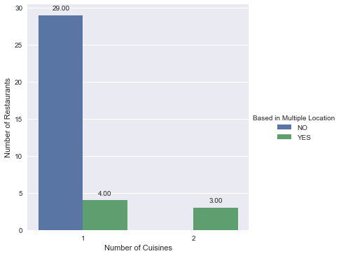
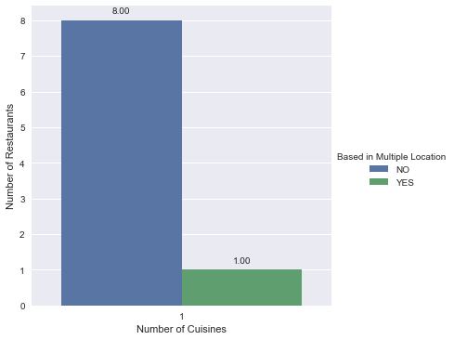
Are there existing Indian Restaurants chains in Ireland if any?
With the previous analysis, for final parts of analysis, I only looked at two administrative Areas Dublin City and County Cork to analyze the restaurants there. And based on further data transformations and aggregation, the following was obtained.
Summary of restaurants serving Indian in Dublin City
Summary of restaurants serving Indian in County Cork
There are three Indian Restaurants in Dublin City based in multiple locations. They are Bombay Pantry, Jewel in the Crown and Indie Spice, and these could be analyzed further.
There are no restaurant chains in county cork that serve other administrative area too.

Slide 17
Future Recommendation
The results obtained in this project are very interesting, especially for those interested further analyzing cuisines and restaurants across Ireland. However, for doing a deeper research, probably all administrative area should be explored.
Another recommendation would be to consider the ratings of the restaurants, using both Foursquare API and google API. This will probably increase the number of datasets we will be looking at.
Conclusion
In this project, I have used data from multiple sources including Foursquare API and Google Places API to perform an analysis of cuisines popularity along selected administrative areas across Republic of Ireland.
The reason for basing our analysis on administrative area was because eventually it is each administrative council that that must be reached out establish a new business in the area. With geographical heat map and bar graphs, the results were presented in an attractive and easy to understand way, allowing to better understand results at each stages of our analysis. This project showcases how useful a geographical data API like Foursquare and Google places API can used be to carry studies about very diverse topics, and how powerful are the Python-based open-source tools.

